Slide 1
Weekly report: Grid Code Development
Week number: 8
Date: 25/11/2025
Supervisor: Prof. Ing. Saiju
Presented by: Josef Remberger / Vijay Simha Reddy Bogala

Slide 2
List of contents
Milestones
PowerFactory Calculations
PowerFactory Simulations
Outlook
Josef Remberger

Slide 3
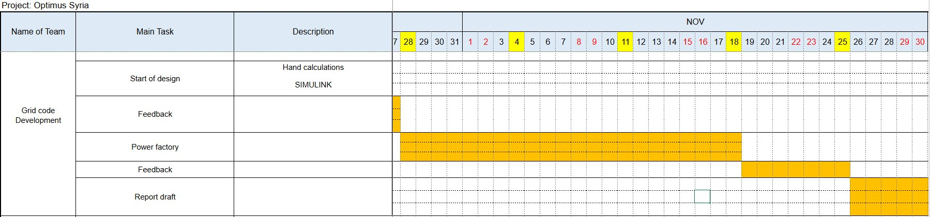
1. Milestones
Josef Remberger

Slide 4

2. PowerFactory Calculations
Three-phase short circuit FRT
  $Z_{grid}= \frac{c ×({V_{grid})}^{2}}{S_{k, max}^{"}}$
  $X_{grid}= \frac{Z_{grid}}{\sqrt{1+({\frac{R}{X})}^{2}}}$ $R_{grid}= \sqrt{{{(Z}_{grid})}^{2}}− \sqrt{{(X_{grid})}^{2}}$
  ${\underline{Z}}_{grid }= R_{grid}+jX_{grid}$
  ${\underline{Z}}_{fault }= \frac{V_{fault} × {\underline{Z}}_{grid}}{V_{grid − V_{fault}}}$
[1]
Josef Remberger

Slide 5
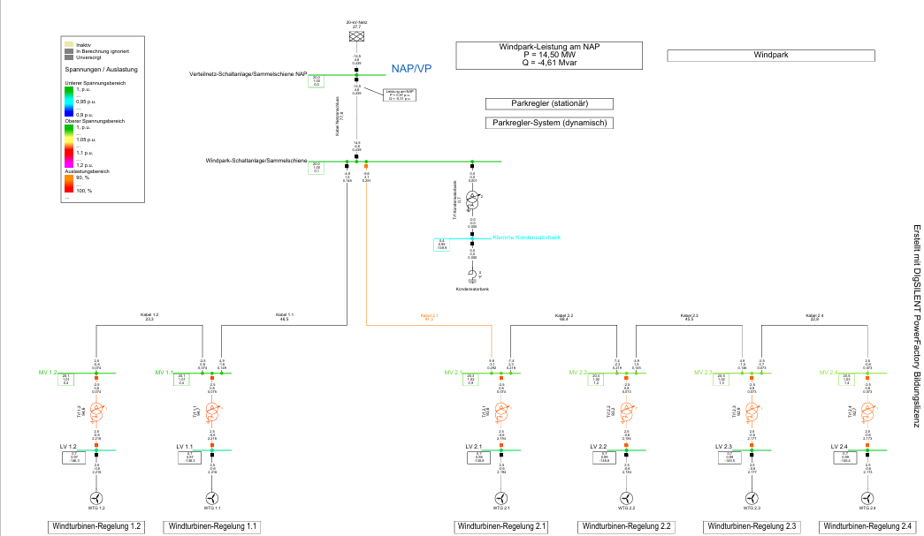
3. PowerFactory Simulations
Grid overview
PowerFactory Template Windfarm; (21/11/2025)
Josef Remberger

Slide 6
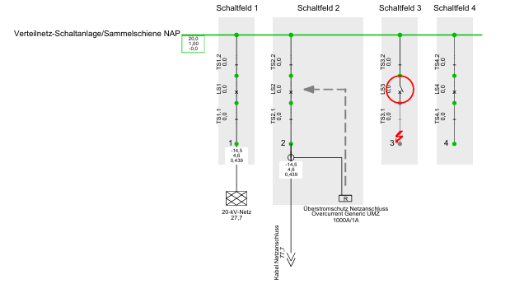
3. PowerFactory Simulations
Short circuit event location
PowerFactory fault location inside the PCC; (21/11/2025)
Josef Remberger

Slide 7
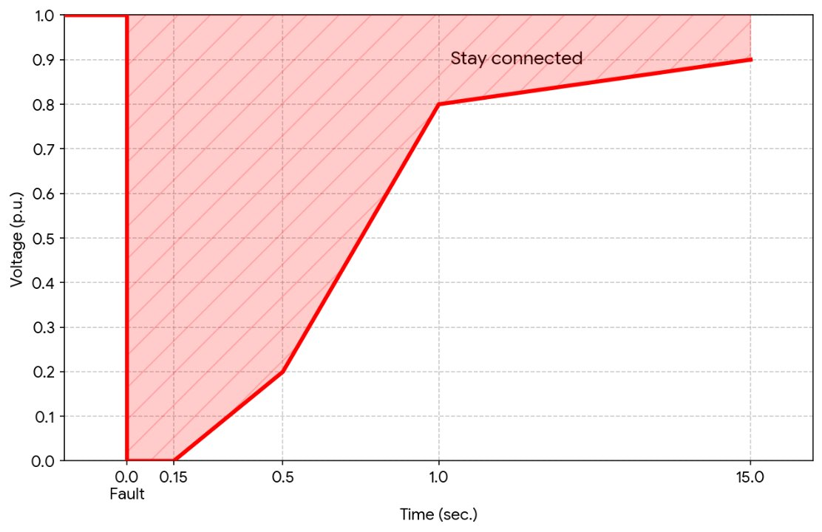
3. PowerFactory Simulations
Calculations based on our predefined LVRT behaviour
[2]; [3]
Improved low voltage ride through behaviour; [2],[3] PETE and VDE-AR-N 4110:2017-02; (22/11/2025)
Josef Remberger

Slide 8
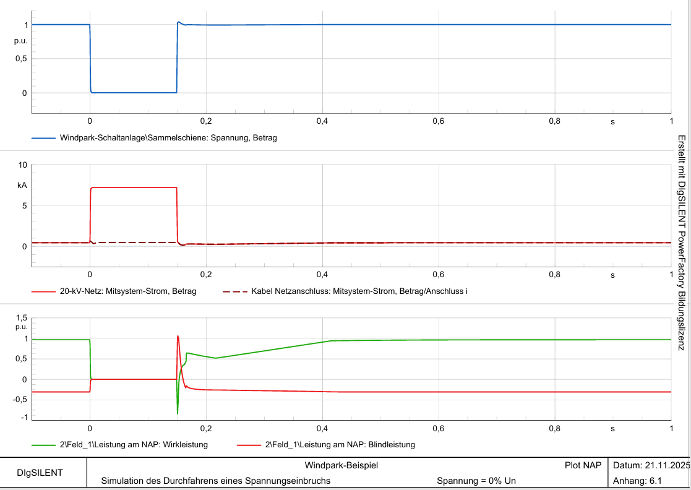
3. PowerFactory Simulations
LVRT: 100% drop / 150 ms
LVRT with 100% drop – simulations on different locations of the system; (22/11/2025)
Josef Remberger

Slide 9
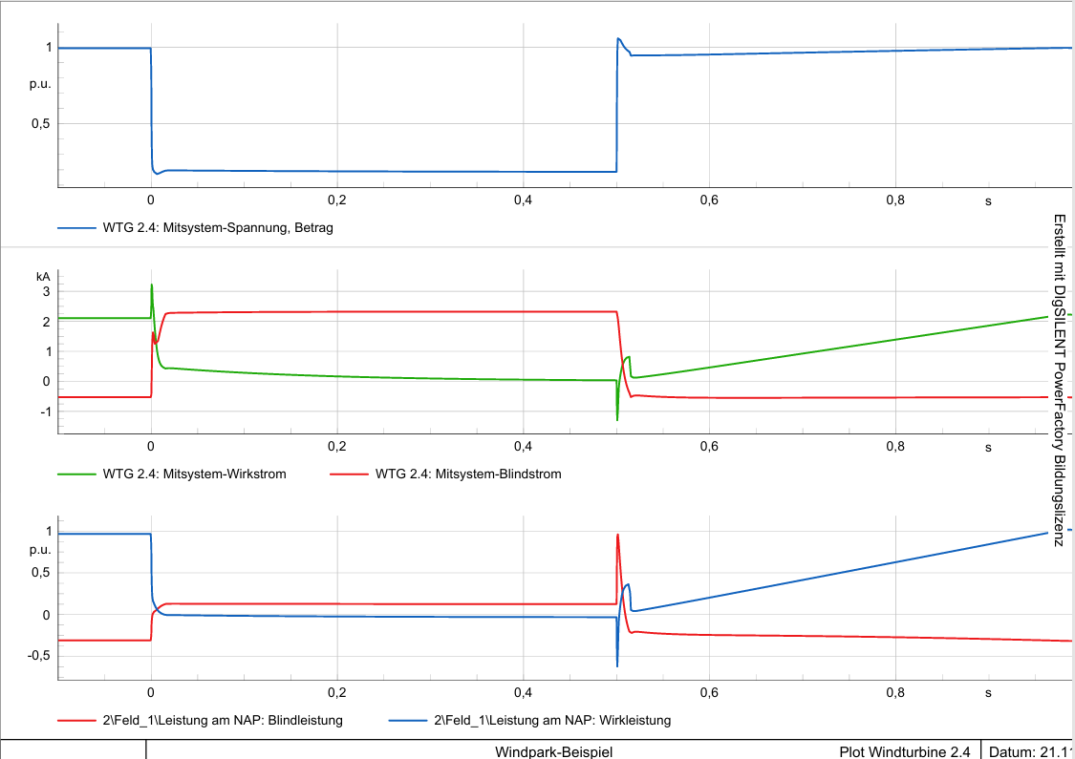
3. PowerFactory Simulations
LVRT: 80% drop / 500 ms
LVRT with 80% drop – simulations on different locations of the system; (22/11/2025)
Josef Remberger

Slide 10
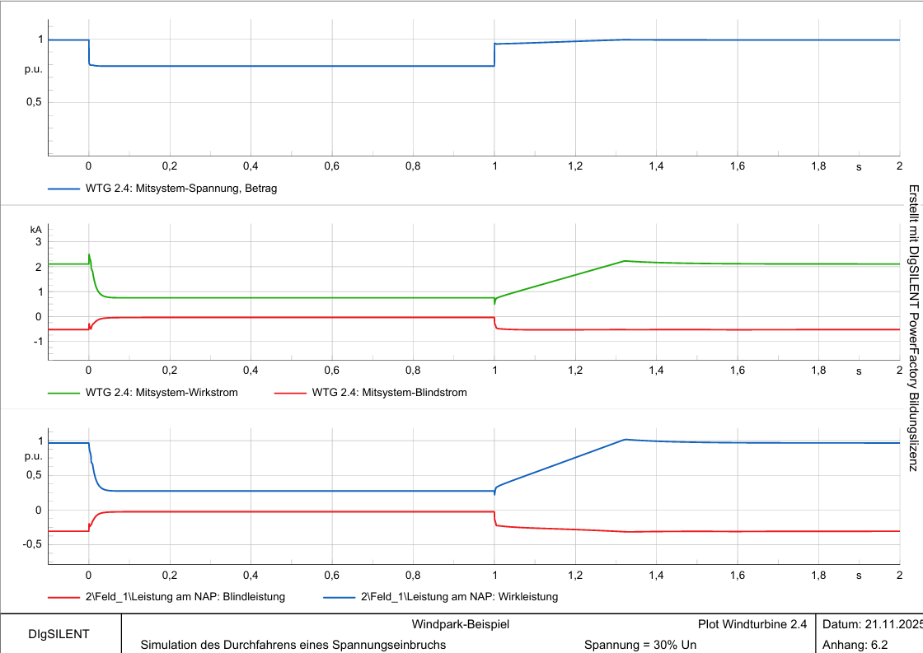
3. PowerFactory Simulations
LVRT: 20% drop / 1000 ms
LVRT with 20% drop – simulations on different locations of the system; (22/11/2025)
Josef Remberger

Slide 11
4. Outlook
Simulation with a 5 MW Turbine class and different amount of turbines
LVRT and HVRT
Applying these calculations also to the current Syrian Grid Code
Josef Remberger

Slide 12
Bibliography – Grid Code Development
[1] Grid Integration-Power System Analysis Lecture, Marc Nottrott, 2025. (accessed Nov. 22, 2025).
[2] SYRRIAN ARAB REPUBLIC / Ministry of Electricity / PETE / Transmission Grid Code, 2014 (accessed Nov. 22, 2025)​
[3] “Summary of the draft VDE-AR-N 4110:2017-02” VDE, 2017. https://eepublicdownloads.entsoe.eu/clean-documents/cnc-active-library/Germany/summary-draft-4110-en.pdf (accessed Nov.22, 2025)

